Slide 1
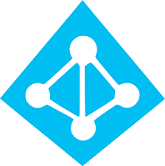
Azure AD & Authorization/Authentication
Team BAM: Brady, Antonio, Miles

Slide 2
What is Azure Active Directory? (Azure AD)
Azure AD is a cloud based Identity and Access management service provided by Microsoft.
The service makes it so that users sign in with their microsoft identities, and Administrators can control who has access to their applications.
Apps no longer need to maintain their own usernames and passwords, as the authentication and authorization of users is handled by Azure Active Directory.

Slide 3
What is Authentication & Authorization?
Authentication (AuthN) is the process of Proving who you really are.
Azure AD simplifies authentication by providing it as a service. Azure AD contains info on users and employees, and users simply provide information that can be authenticated by it.
Authorization (AuthZ) is the act of granting an authenticated party permission to do certain actions.
Access tokens contain Authorization information, which is what allows users to access private applications.

Slide 4
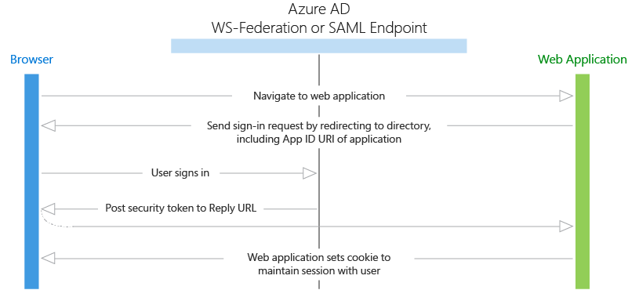
What happens?
The user will attempt to use the intended web application. They will be redirected to the Sign-In page provided by the Azure Active Directory. The user will be required to enter their information, such as their Username and Password.
Tenants can determine which accounts have access to the application. The user may be asked to provide consent to allow access to personal data. After this, a security token is created, and this allows users to interact with Web Applications.

Slide 5
Tenants
Tenant: A dedicated instance of an Azure Active Directory.
There exists one tenant per organization. An organization/App developer receives one Tenant after creating a relationship with Microsoft (Signing up for Azure or Office 365). More tenants can be created afterwards.
Tenants have their own representation of work/school identities, consumer identities, and app registrations.
Tenants can register apps, access Microsoft 365 data, and deploy customized conditional access and tenant restrictions.

Slide 6
Tenants continued
Tenants can allow for authentication of accounts, based on what accounts are located within the tenant itself. For single-tenant applications, add the Tenant Name or ID when it asks for Tenant Id, and only accounts in that organizational directory will be used. Use one the following keywords for multi-tenant applications...
“organizations” = Only for work and school accounts.
“consumers” = Only for personal microsoft accounts.
“common” = For personal, work, and school accounts.

Slide 7
Consent
Resource Owner: The entity capable of granting access to a protected resource, such as an end user giving permission to an app to view its mail.
Resource Server: A server with access to protected resources that can respond to requests from clients with Access Tokens.
Consent: Process of a resource owner granting a client application access to protected resources. Usually happens after signing in from different tenants.

Slide 8
Application Object and Service Principal Object
When an Azure AD application is registered, two objects are created: the Application Object and Service Principal Object.
Application Object: Defines the application’s identity configuration. It resides in the Azure AD tenant that it was created in. These are used as a template to create a Service Principal Object.
It is considered Global.

Slide 9
Security Principal Object
Service Principal Object: A security principal object created at the same time as the application object for the original tenant.
It is considered Local. Additional Service Principal objects are created for every tenant a user consents to the application through. It is created based on the template of the application object. This object defines the access policy and permissions for the application and allows for authentication during sign-in and authorization during resource access.
A User Principal Object is also a Security Principal Object, and represents the user identity, allowing for authentication in Single Sign On, making access control decisions, and more.

Slide 10
Security Tokens
Security tokens: Signed documents that contain claims.
Claims: Claims provide assertions about one entity (Resource Owner) to another entity (Resource Server).
Claims are name/value pairs that contain facts about the token subject, such as the the date of creation, the subject in question, & the application that asked for the token.
JSON Web Token (JWT): How the tokens are written. These typically contain a Header (information on how to validate), Payload (information on user connecting to service), and Signature (What is validated).

Slide 11
Access Tokens
Access Tokens are a type of Security token, usually using JSON Web Tokens, issued by an Authorization server. It allows access to Web APIs and other protected resources.
Access tokens contain information about the authorization given to the client by the resource owner.
The claims within the token can be used as credentials when accessing specific resources without exposing them to the client.

Slide 12
ID Tokens
ID Tokens are a Security token that use JSON Web Tokens. They are provided by an Authorization server’s authorization endpoint. They contain claims referencing the end user, and can be used to provide information to the application.
Unlike Access Tokens, the claims of an ID token are not used for resource access or access control. They can be used for validating the user’s identity, but not for authorization.

Slide 13
Tokens (continued)
Tokens are signed by the Security Token Server (STS) with a private key. The STS also provides a corresponding public key.
To Validate tokens, the public key is used to validate that the signature was created by the private key. Other aspects that can be validated include claims, the issuer, the audience, and the signing tokens.
Azure AD middleware has built-in capabilities for validation.
The STS provides the access token as well as a refresh token. These tokens are tasked with refreshing the access tokens when close to expiring.
Access tokens are sent in the authorization header to the Web API.

Slide 14
Why should we use Azure AD?
Single Sign On (Explained in next slides)
Access Panel (Explained in next slides)
Admins do not have to manage multiple logins for multiple services
Avoid url injection
You can add multi factor authentication
Works in many platforms and devices
Comprehensive reporting
Security Reports: get an overview of compromised accounts and sign-in attempts
Activity Reports: history of all tasks performed and who performed it
Azure AD B2C
Create a tenant for your application and Azure AD will take care of identity management

Slide 15
Single Sign On (SSO)
Sign in once and have access to all services
Used in SaaS applications
No need to sign in again to use a different service
When you sign in, AAD sends a token to the web app
A cookie is saved in the browser with the identity of the user
Next time you are required to sign in, the browser presents the cookie
An application that makes use of this is Microsoft Office 365
Sign in once with your Microsoft Account and have access to Word, Excel, PowerPoint, etc.
No need to create new account to use Access or Publisher after using Word
Another example is Google
When you sign in to gmail, you are also signed to youtube

Slide 16
Access Panel
It is really useful to have Microsoft Portal as home page for your application
You do not have to create a sign in/sign up page. Microsoft does it for you
Account Management
Example: Password reset
This can have more security by providing extra security challenges (like following link to email)
Can be accessed from supported websites and mobile devices

Slide 17
It is COOL :)!

Slide 18
How do we use Azure AD and Authentication/Authorization?

